Slide 1

Hospitality Analytics
P1194 Hospitality Analytics Project by GROUP 3
Tools used : Excel, PowerBI, Tableau and SQL

Slide 2

Group-3 Members
Jithu Puthukary Jose
Ankit Kumar Mishra
Kritika Rajesh Keoti
Ankit Mishra
Mohammad Rehaan Ali
Jayesh Vivek Kale
Arya K

Slide 3
Project Objective
To analyze the Shodwe Hotel’s hospitality booking data and evaluate hotel performance.
To understand revenue trends across different cities and properties.
To analyze booking patterns based on room class, booking platform, etc.
To generate the key performance indicators such as Total Revenue, Occupancy Rate, etc. using SQL queries.
To create interactive dashboards using Excel, PowerBI and Tableau for better business decision-making.
To transform the raw hospitality data into insights using data analysis techniques.

Slide 4
Key Performance Indicators used
Total Revenue – Total income generated from all property bookings.
Total Bookings – Total numbers of reservations made.
Occupancy Rate – Percentage of rooms occupied compared to total available rooms.
Revenue per Available Room (RevPAR) – Measures how efficiently hotel rooms generate revenue.
Average Daily Rate (ADR) – Average revenue earned per occupied room.
Average Customer Rating – Average guest satisfaction rate.

Slide 5
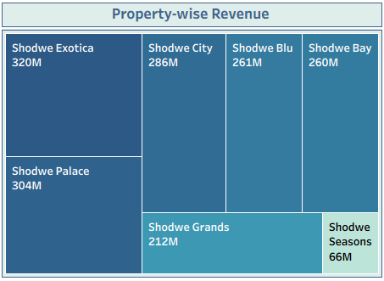
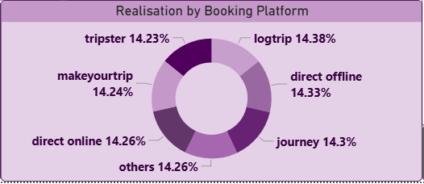
VISUALIZATIONS
Treemap visualization shows the revenue contribution by property.
Helps identify top-performing hotels and underperforming properties, for better strategic planning.
Analytics highlights booking platforms which are most effective in generating revenue for hotels.
Certain platforms contribute to larger share of realized revenue and show higher booking.

Slide 6
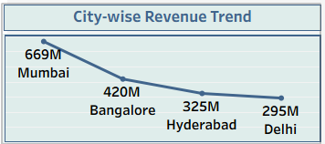
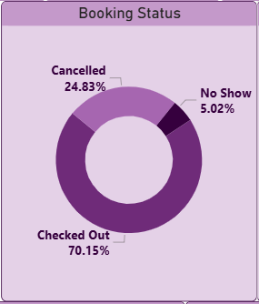
VISUALIZATIONS
Line chart shows revenue varies across cities over time
Helps to identify city-wise overall performance trends.
Visualization shows distribution of booking status.
Monitoring booking status helps hotels understand customer behaviour and improve management strategies.

Slide 7
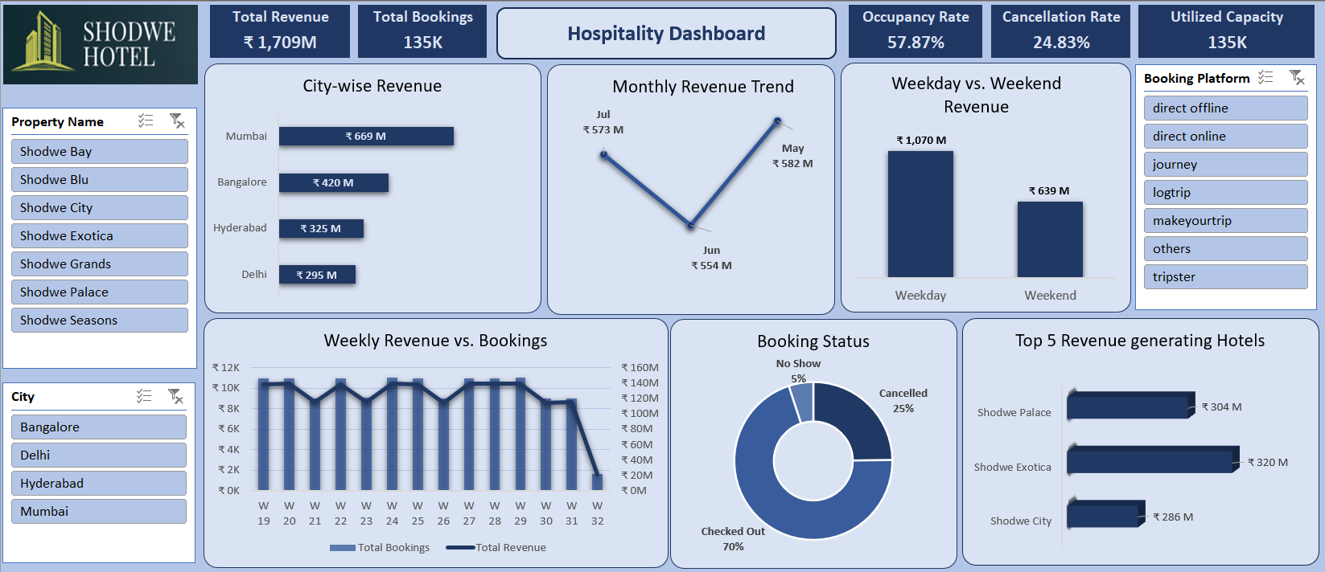
Excel Dashboard

Slide 8
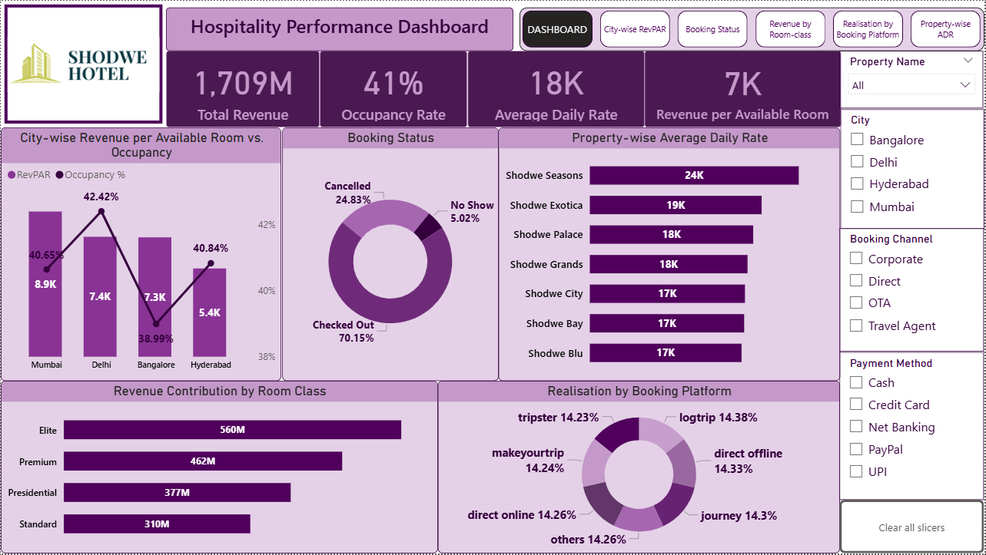
PowerBI Dashboard

Slide 9
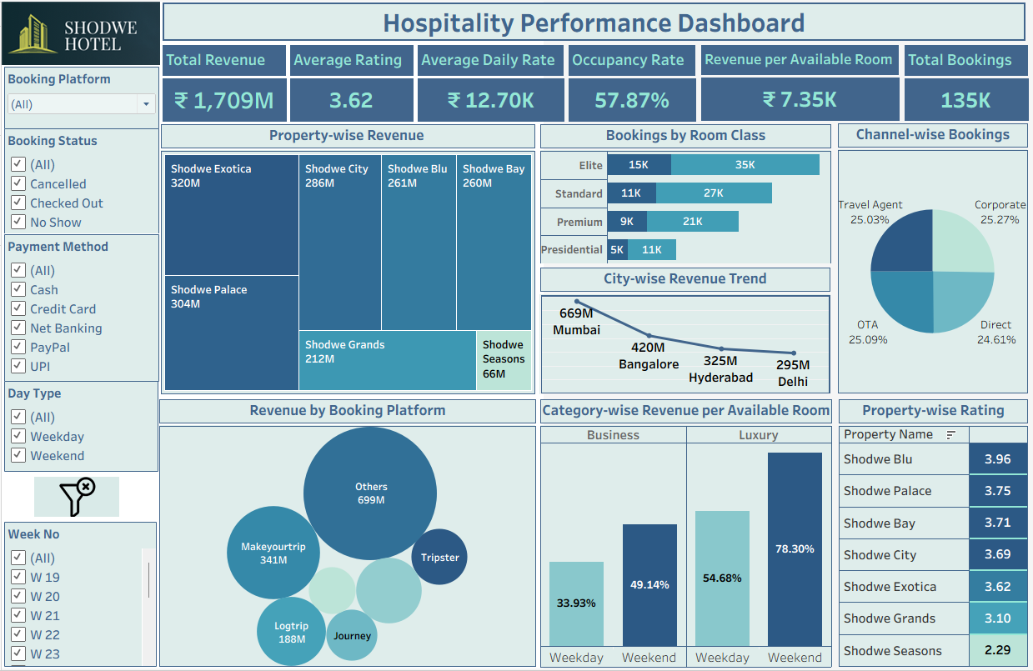
Tableau Dashboard

Slide 10
Key Insights from Analysis
Mumbai generates the highest revenue among cities.
Weekend occupancy rates are higher than weekdays.
Premium and Elite room classes contribute the largest share in revenue.
Some properties like Shodwe Exotica and Shodwe Palace generate higher revenue than others.
OTA and Travel Agent channels generate significant bookings.
Certain booking platforms generate larger number of hotel bookings.
Customer ratings vary across properties, indicating differences in guest experience.

Slide 11
Conclusion
Dashboards created with data visualization tools help identify important trends in revenue, bookings, and customer behaviour.
Analysis provides useful insights that can help Shodwe Hotels’ managers
  monitor performance metrics
  identify opportunities for growth
  improve overall management strategies.
THANK YOU!

